Slide 1
Early Detection of Alzheimer's Disease using CNN Model
Hari Priya Avarampalayam Manoharan
Rida Fathima
Subramanian Arumugam
Agash Sekar
Abinesh G

Slide 2
Motivation & Problem

Slide 3
Problem
Importance of early diagnosis | Early diagnosis is critical for better disease management and treatment
Current diagnostic methods | Neurological exams, cognitive tests, and brain imaging techniques
Limitations of current methods | Time-consuming, expensive, and may not be accurate in the early stages of the disease

Slide 4
Proposed Solution
A CNN Model which does image analysis on MRI images and give an early diagnosis of Alzheimer’s disease.

Slide 5
Dataset Description

Slide 6
Training set:
(4098,150,150,3)
Testing set:
(1024,150,150,3)
The Mild Demented and Moderate Demented classes indicate the presence of significant cognitive decline. ‘
The Non Demented class represents a normal cognitive function.
The Very Mild Demented class indicates a very early stage of cognitive decline.
Classes
Mild Demented
Non Demented
Moderate Demented
Very Mild Demented

Slide 7
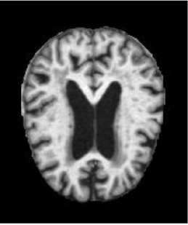
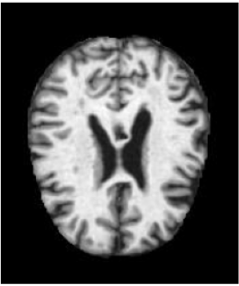
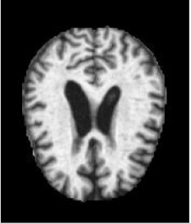
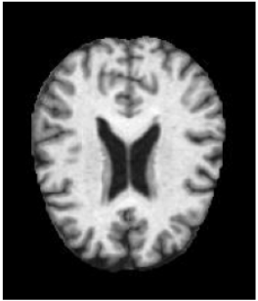
Mild Demented
Very Mild Demented
Moderate Demented
Non Demented

Slide 8
Data Preparation

Slide 9
Checking for Missing Values
One hot Label Encoding
HOG Feature Extraction
Caching and prefetching data

Slide 10
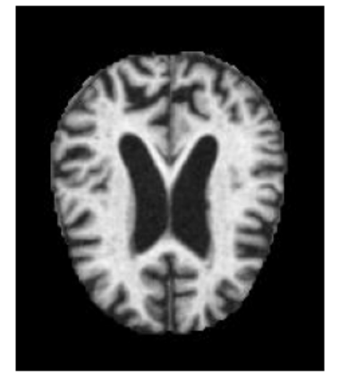
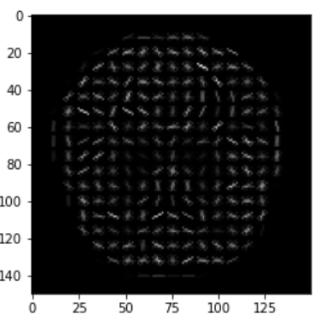
HOG Feature Extraction
Histogram of Oriented Gradients (HOG) is a technique that captures local gradients of an image and uses them as features

Slide 11
Modeling

Slide 12
Activation Function | Output size | No of Parameters | No. Of Filters
Relu | (148, 148, 16) | 448 | 16
Relu | (146, 146, 16) | 2320 | 16
MaxPooling2D | (73, 73, 16) | 0 | 0
Relu | (73, 73, 32) | 1376 | 32
Relu | (73, 73, 32) | 2080 | 32
BatchNormalization | (73, 73, 32) | 128 | 0
MaxPooling2D | (36, 36, 32) | 0 | 0
Relu | (36, 36, 64) | 4160 | 64
Relu | (36, 36, 64) | 8256 | 64
BatchNormalization | (36, 36, 64) | 256 | 0
MaxPooling2D | (18, 18, 64) | 0 | 0

Slide 13
Activation Function | Output size | No of Parameters | No. Of Filters
Dropout | (18, 18, 64) | 0 | 0
relu | (18, 18, 256) | 16640 | 256
relu | (18, 18, 256) | 65792 | 256
BatchNormalization | (18, 18, 256) | 1024 | 0
MaxPooling2D | (9, 9, 256) | 0 | 0
Dropout | (9, 9, 256) | 0 | 0

Slide 14
Activation Function | Output size | No of Parameters | No. Of Filters
Flatten | 20736 | 0 | 0
relu | 512 | 10619904 | 0
BatchNormalization | 512 | 2048 | 0
Dropout | 512 | 0 | 0
relu | 128 | 65664 | 0
BatchNormalization | 128 | 512 | 0
Dropout | 128 | 0 | 0
Relu | 64 | 8256 | 0
BatchNormalization | 64 | 256 | 0
Dropout | 64 | 0 | 0
Dense (softmax) | 4 | 260 | 0

Slide 15
Result

Slide 16
No. Of Epochs | Training Accuracy | Testing Accuracy
7 | 0.77 | 0.76
50 | 0.8983 | 0.7536

Slide 17
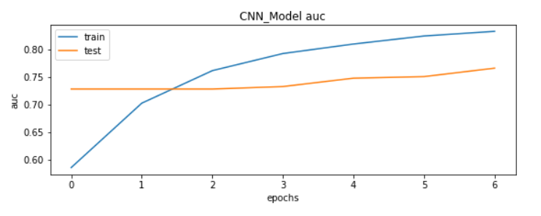
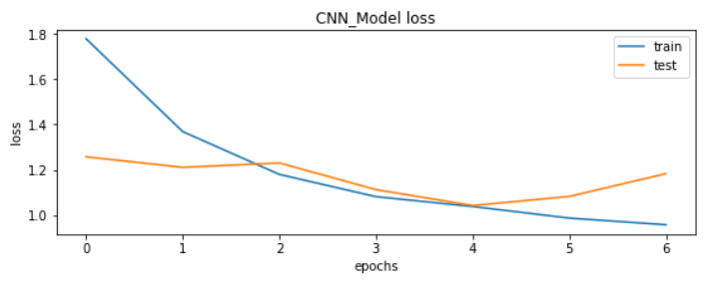
Results for Epoch =7

Slide 18
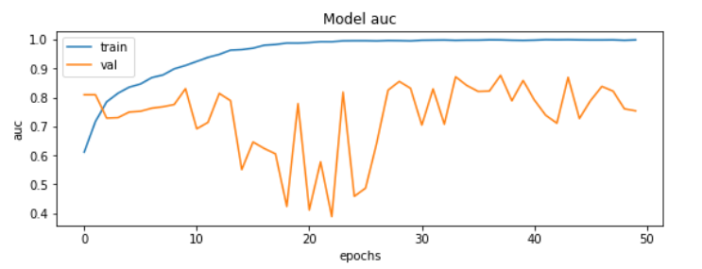
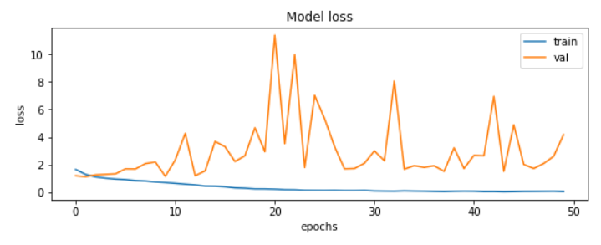
Results for Epoch =50

Slide 19
Thank You

